Slide 1
CT Classroom
A Learning Management Website
For colleges ,schools and individuals.

Slide 2
What is LMS?
LMS is abbreviated form for Learning Management System. It is a website for e-learning program and training contents.
This Application includes :
Adminstration, Teachers and students
Classes and online Tests
Tracking and reporting of tasks and assignments
Forums to intract between the students and teacher
Display scores and trascript.
Notice board
Recorded class videos

Slide 3



Slide 4
User Roles
Admin : A person responsible for general system, teacher management and course setting.
Teacher : A person responsible for creating and adminstering topics and lessons for courses and managing whole learning process.
Student : A learner enrolled into one or several courses.
Parents : Role of parents is just to track the performance of their child.

Slide 5
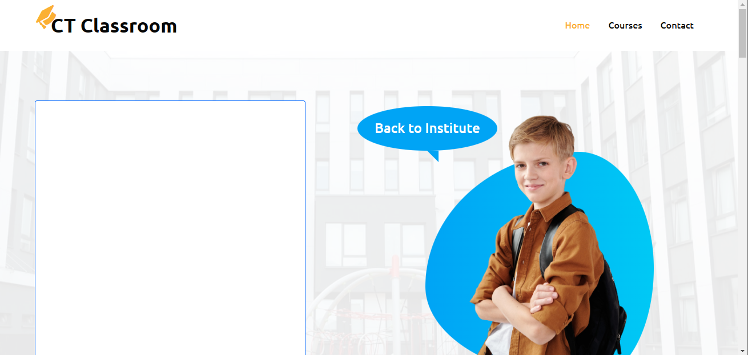
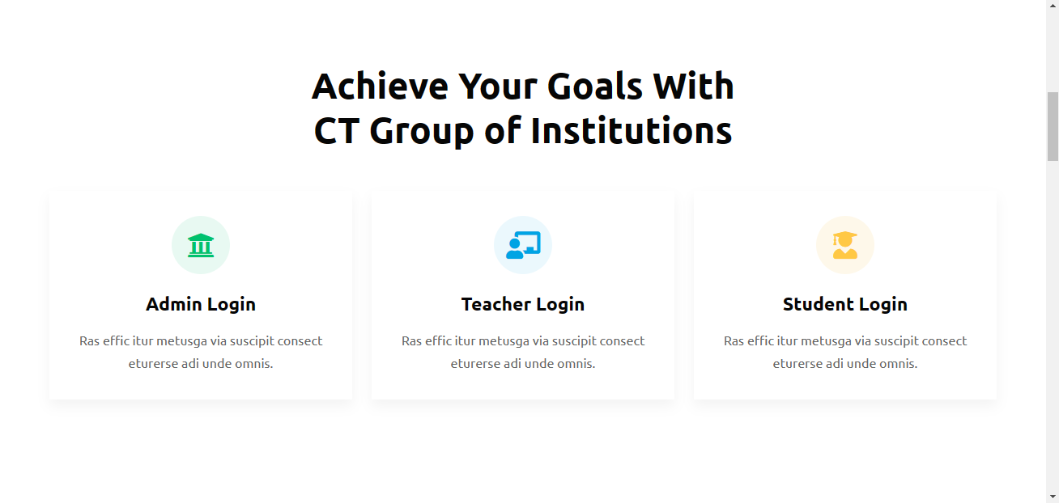
Main Screen of the website

Slide 6
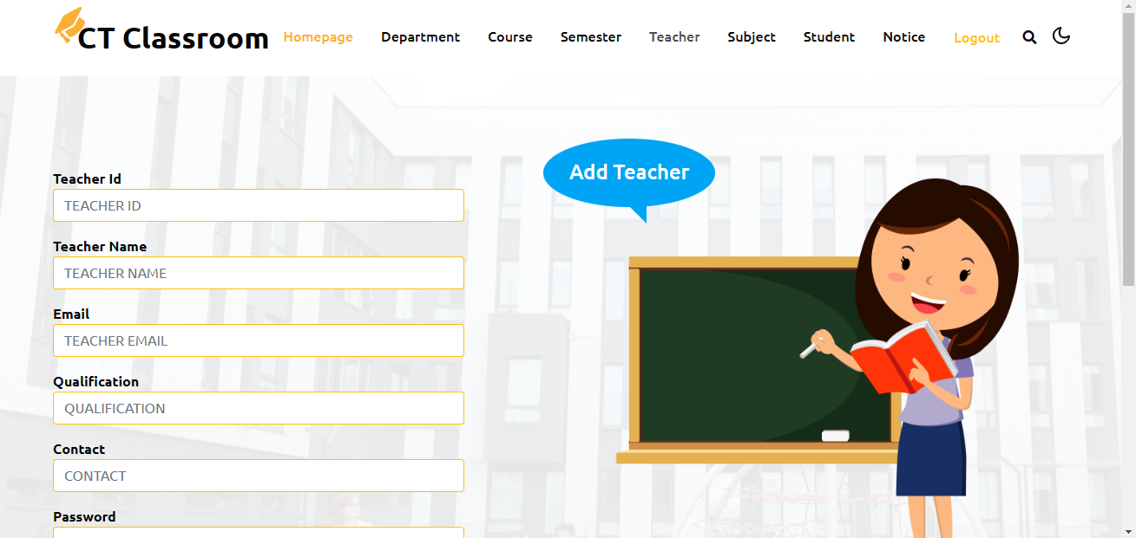
Admin Dashboard

Slide 7
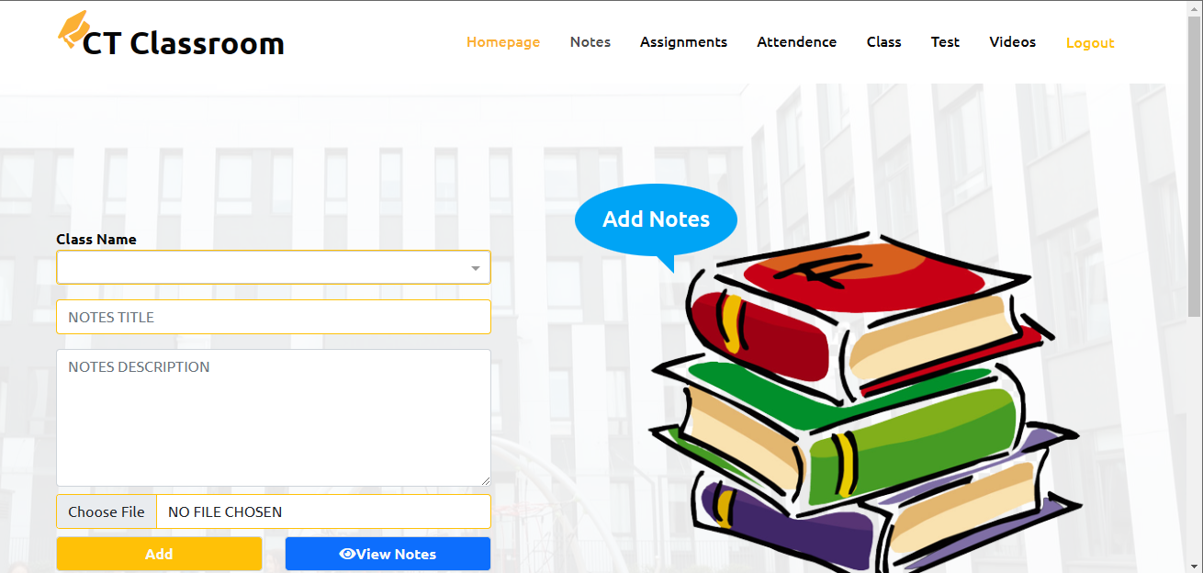
Teacher’s Dashboard

Slide 8
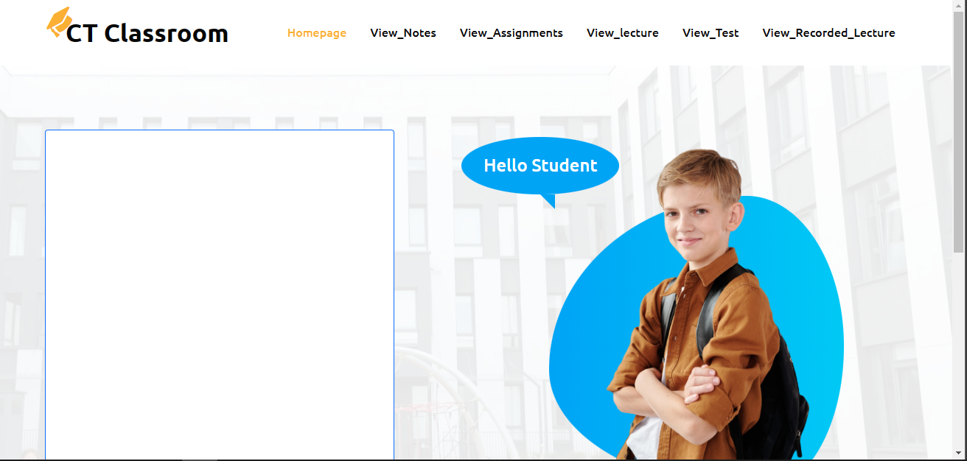
Student’s Dashboard

Slide 9
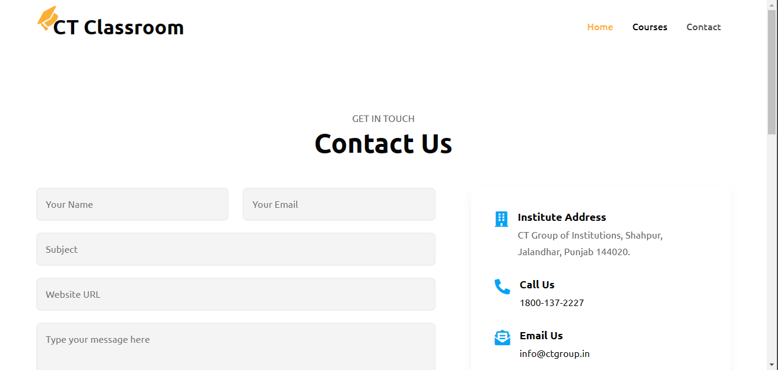
Contact Form

Slide 10
Future scope
Email system with notification.
Availability of some paid courses.
Regular reporting to parents

Slide 11
Questions?

Slide 12
THANK YOU !

